Slide 1
Equity & Diversity
Board Committee
May 13, 2021

Slide 2
Equity & Diversity Committee
Board Members
Mark Abate, Co-Chair
Paul Lambert
CO Administrators
Sharee Wells, Asst Supt, Co-Chair
Samantha Chatman, Equity & Div Dir
Samantha Althouse, Sec Educ Dir
Building Administrators
Joyce Brickley, HDB Prin
Matt Trombitas, HMS Prin
Katie Salyer, HHT Prin
HEA & OAPSE Representatives
Nikki Henkel, Media Spec, HDB
Jody Hume, Intv Asst, HDB
Lisa Lewis, Intv Asst, HMS
Janet Monseur-Durr, E&I Teacher, ILC
Tom Regouski, Teacher, WSH
Notes:
Sharee

Slide 3
Board Resolution
The Hilliard City School District rejects all forms of racism as destructive to the District's mission, vision, values, and goals.
The Board of Education and District Administration is committed
to the following:
Establishing and sustaining a school culture and community that shares in the collective responsibility to address, eliminate, and prevent action, decisions, and behaviors that permit or perpetuate racism.
Establishing and supporting the Director of Equity and Diversity, the Diversity Coordinators, and the Equity and Diversity Task Force to lead the Hilliard City School District’s commitment to eliminating inequitable practices.
Respecting and championing the diversity and life experiences of all students and staff to support the school district’s mission, vision, values, and goals.
Creating a three-year strategic plan, under the Director of Equity and Diversity leadership, includes policy recommendations, recruitment of a more representative workforce, curriculum review and guidance, and system support to target systemic racism in the District.
Notes:
Mark

Slide 4
Purpose and Vision
Oversee the implementation and monitoring of the district’s Equity and Diversity Action Plan
Develop and recommend policies
Communicate the work of the district and committee to the broader community
The committee is to be advisory only

Slide 5
Roles and Responsibilities
Review and ratify the district’s Equity and Diversity Action Plan
Identify the priorities and timeline
Develop a process for implementation and progress monitoring (ex., Gantt chart)
Define a strategy for keeping the community engaged
Notes:
Paul

Slide 6
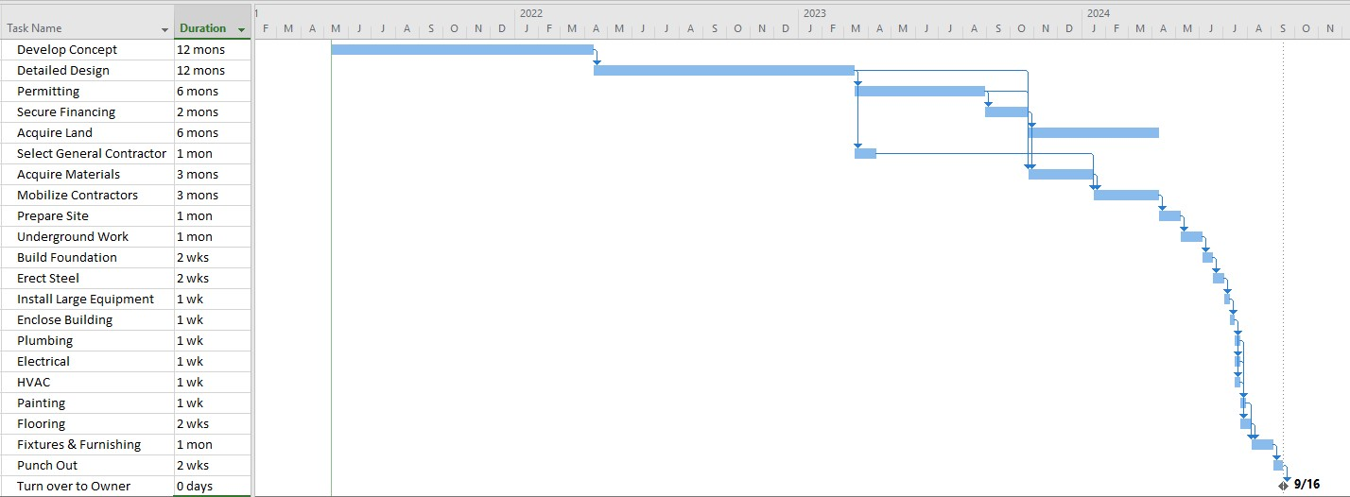
Gantt Chart – Progress Monitoring Example
Notes:
Paul

Slide 7
Task Force Groups
Task Force Groups
Professional Development Teacher and Staff Training Opportunities | Hiring Hire and Retain staff of Color
Discipline/Policy Review Discipline Procedures and Policy Recommendations | Curriculum Review Curriculum to create inclusive, anti-racist/anti-bias curriculum for all students
Notes:
Samantha

Slide 8
Professional Development
GOALS
Mandatory training for administrators and principals
Mandatory training for staff (certified & classified) during contractual time
Community outreach
Notes:
Samantha

Slide 9
Curriculum
GOALS
Revise K-12 ELA resources to include multiple cultural perspectives
Develop process for reviewing current curriculum maps
Foster an inclusive environment for all students and staff
Notes:
Samantha

Slide 10
Discipline/Policy
GOALS
Update the Student Handbook to specifically address racism and racist incidences
Establish a student reporting & incident tracking system (“Hotline”)
Create Staff Code of Conduct against discrimination & tracking/accountability system
Expand Restorative Practices to ensure equitable disciplinary practices
Notes:
Samantha

Slide 11
Hiring
GOALS
“Grow Our Own” BIPOC teachers and teachers from under-represented groups from our currently employed classified staff
“Grow Our Own” BIPOC teachers and teachers from under-represented groups from our current HCSD students
Recruit BIPOC and underrepresented educators to work in Hilliard City Schools
Ensure Hilliard City Schools is an inclusive place to work
Notes:
Samantha

Slide 12
Next Steps
Summer Work
Why Are All the Black Kids Sitting Together in the Cafeteria?
By Beverly Daniel Tatum
Optional Book Discussion and Reflection
Wednesday, August 11, 4-5:30 pm
Notes:
Sharee

Slide 13
Future Meetings
First Meeting of the 2021-22 School Year
Thursday, Sept. 7, 4:00-5:30 pm
Regular Meetings
Monthly
The first Tuesday of every month
Notes:
Sharee

Slide 14
Questions/Discussion
Notes:
Mark

